Slide 1

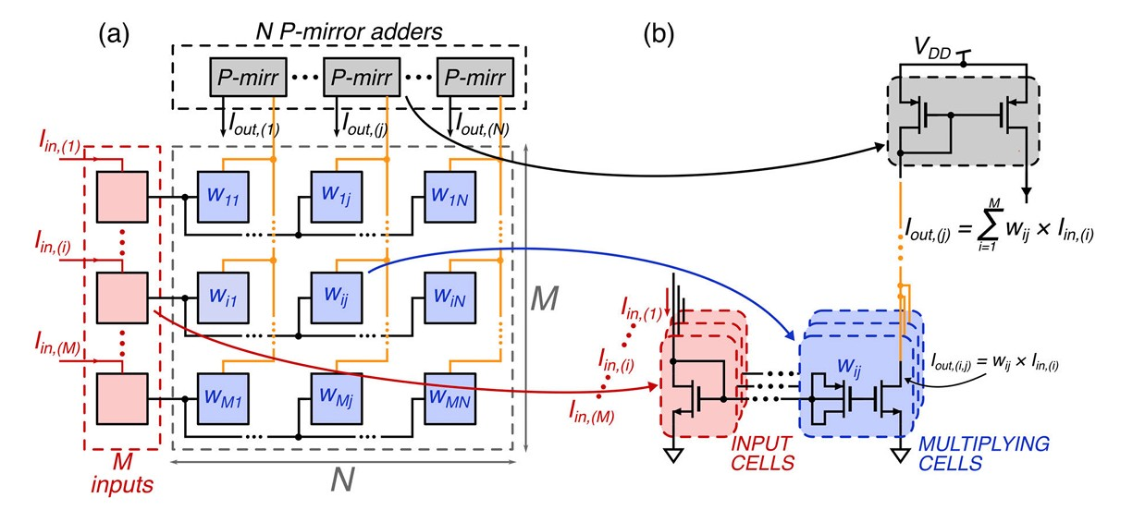
Analog VMM analysis
Notes:
1

Slide 2

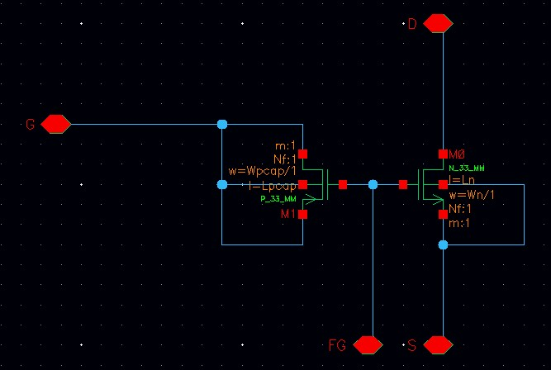
Floating gate cell design
The floating-gate cell used is made up of an n-mos with a p-cap connected in series with the gate.
The value of the voltage stored in the p-cap, being a drop in series with the mos gate, has the same effect as an increase in the threshold voltage (Vth).
Notes:
2

Slide 3

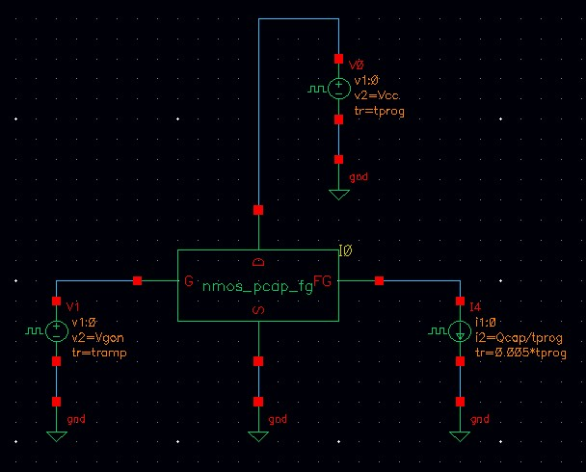

Weak inversion polarization of the n-mos cell
The single n-mos cell must work in weak inversion, for this reason the drain current have to be limited to a maximum value calculated as follows.
$$\frac{I_{ds}}{I_{dspec}}≤\frac{1}{10} →I_{ds}≤\frac{I_{dspec}}{10}=\frac{I_{dspec}^{′}\frac{W}{L}}{10}$$
Were $I_{dspec}^{′}≅0,2μA$ and $W/L$ is the aspect ratio of the n-mos.
With the simulation we want to verify that with the calculated drain current, the n-mos work in weak inversion.
Notes:
3

Slide 4
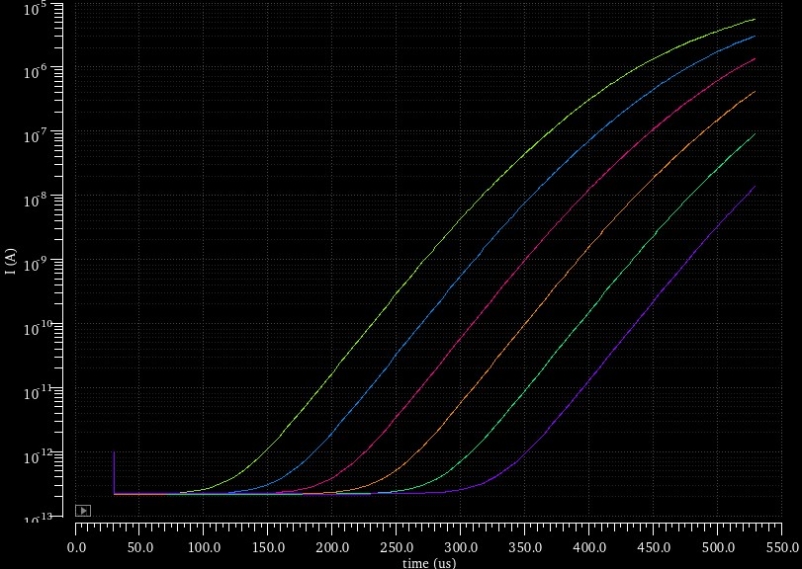

The simulation is performed by charging the p-cap with different charge values and applying a voltage ramp to the gate of the n-mos, while measuring the drain current.
The gate voltage goes from 0V to 1V
The p-cap charge goes from 1fC to 20fC with 6 steps
The n-mos aspect ratio is Wn/Ln=1um/0,8um
The drain source voltage is Vds=1V
As we can see from the graph, the curve are linear when the drain current is under approximately $20nA$.
With the n-mos dimension analysed the maximum drain current is $I_{ds}≤\frac{I_{dspec}^{′}\frac{W}{L}}{10}≅25nA$
Notes:
4

Slide 5
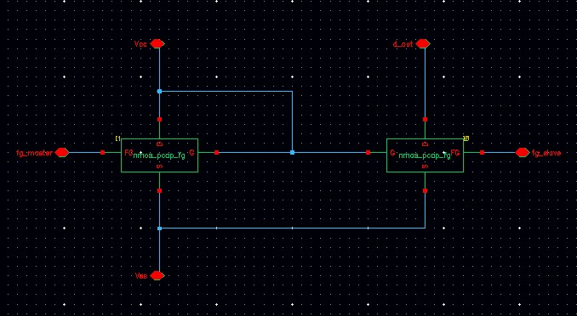

Current mirror cell design
Two floating gate cells are used to make a current mirror.
The voltage drop on the p-cap produce a shift of the threshold voltage determining the current magnification factor of the mirror.
The n-mos are in weak inversion, so the output current is calculated as follows
$$I_{out}=I_{in}∙e^{\frac{∆V_{th}}{mV_{t}}}$$
Notes:
5

Slide 6
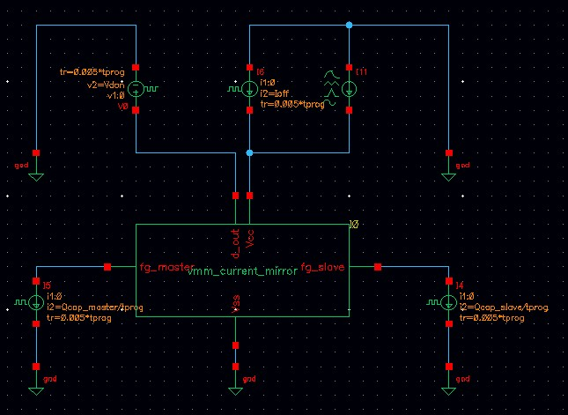

Magnification factor analysis for the current mirror
The output current value of the current mirror is calculated as follows.
$$\left\{\begin{aligned}I_{out}={w∙I}_{in} \\ w=e^{\frac{∆V_{th}}{mV_{t}}}\end{aligned}\right.$$
The magnification factor was evaluated by charging the p-cap with different charge levels and measuring the mirror’s output current with a sinusoidal input current applied.
Notes:
6

Slide 7
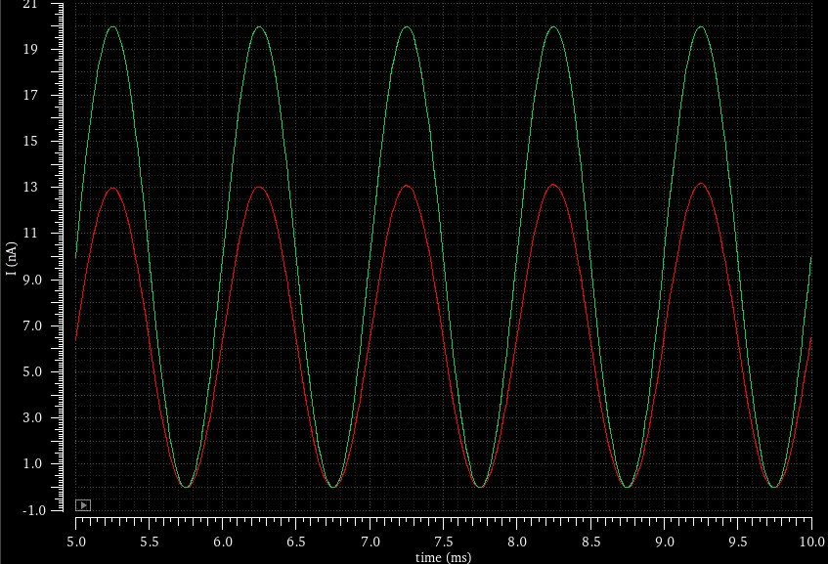


The green sinusoidal wave is the input current that goes into the master transistor
The red sinusoidal wave is the output current from the slave transistor
The dimensions for the n-mos and for the p-cap are
Wn/Ln = 1um/0,8um
Wpcap*Lpcap = 5um*5um
The p-cap is charged with 1fC and the drain voltage is Vds=600mV
The magnification factor from the analysis is
$$w=\frac{I_{slave}}{I_{master}}≅0,65$$
The theoretical calculated value is
$$w=e^{\frac{∆V_{th}}{mV_{t}}}=e^{\frac{−Q_{cap}}{mV_{t}∙{W_{cap}L_{cap}C}_{ox}}}≅0,60$$
Notes:
7

Slide 8
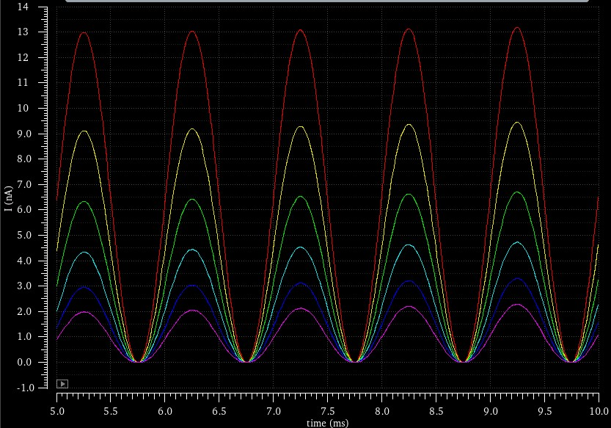
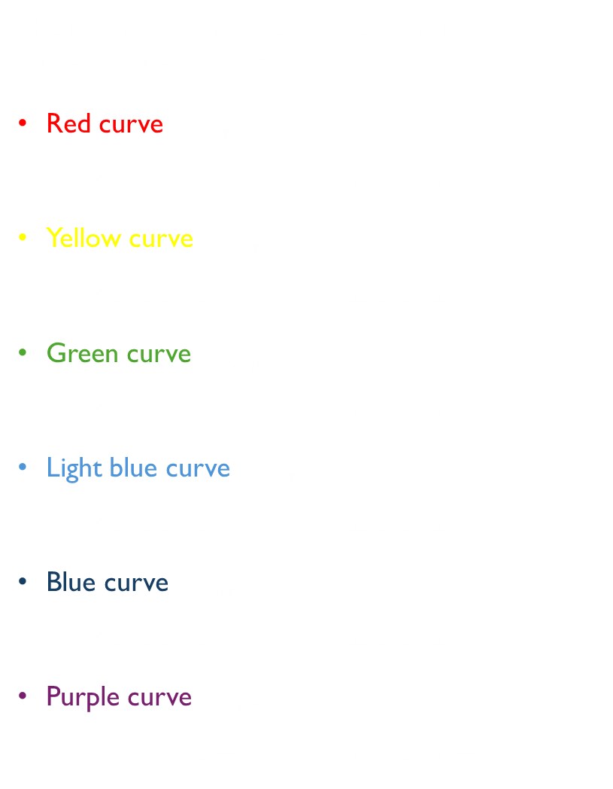
After the first analysis we applied different value of charge at the p-cap to see the variation of magnification value
The charge value applied goes from 1fC to 5fC with a step size of 0,8fC (resulting in 6 steps)
The magnification values corresponding to each curve are the following
Red curve ($Q_{cap}=1fC$)
$$w_{simulated}≅0,65; w_{calculated}≅0,60$$
Yellow curve ($Q_{cap}=1,8fC$)
$$w_{simulated}≅0,45; w_{calculated}≅0,40$$
Green curve ($Q_{cap}=2,6fC$)
$$w_{simulated}≅0,31; w_{calculated}≅0,26$$
Light blue curve ($Q_{cap}=3,4fC$)
$$w_{simulated}≅0,21; w_{calculated}≅0,18$$
Blue curve ($Q_{cap}=4,2fC$)
$$w_{simulated}≅0,15; w_{calculated}≅0,12$$
Purple curve ($Q_{cap}=5fC$)
$$w_{simulated}≅0,10; w_{calculated}≅0,08$$
Notes:
8

Slide 9
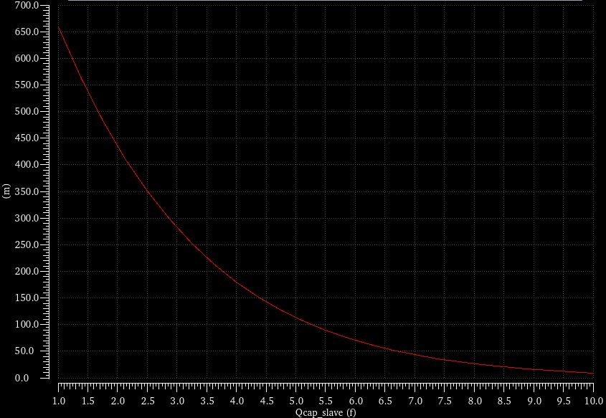
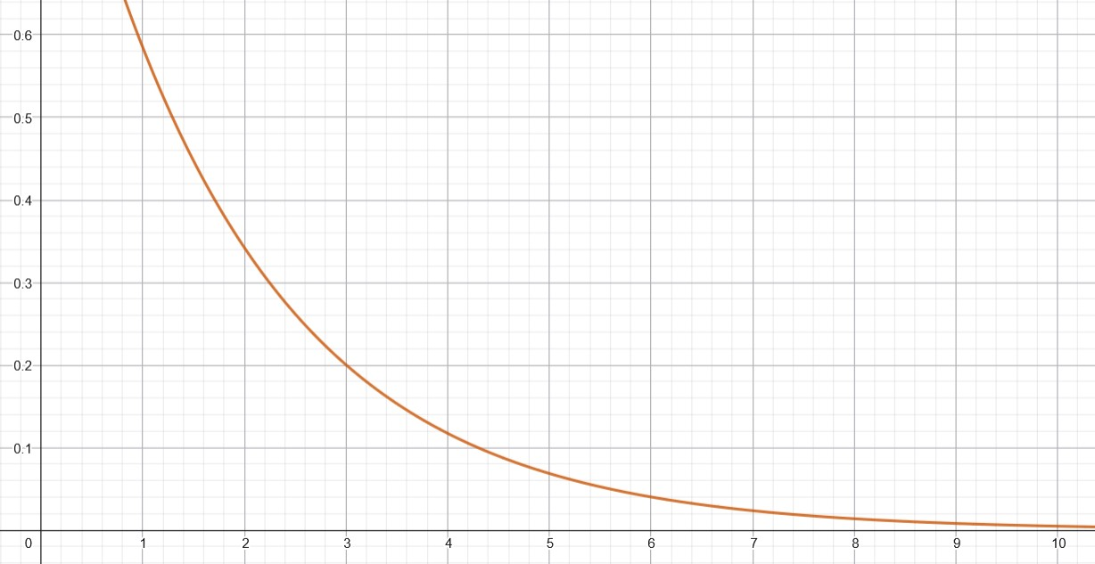

The magnification factor (equal to the weight of the cell) function to the charge into the p-cap is the following.
With a charge swing from 1fC to 10fC we can program the magnification factor from 0,65 to almost zero.
Comparing the result with the theoretical function calculated earlier
$$y\left(x\right)=e^{−\frac{x∙{10}^{−15}}{1,866∙{10}^{−15}}}$$
the result follows the model pretty well.
Notes:
9

Slide 10
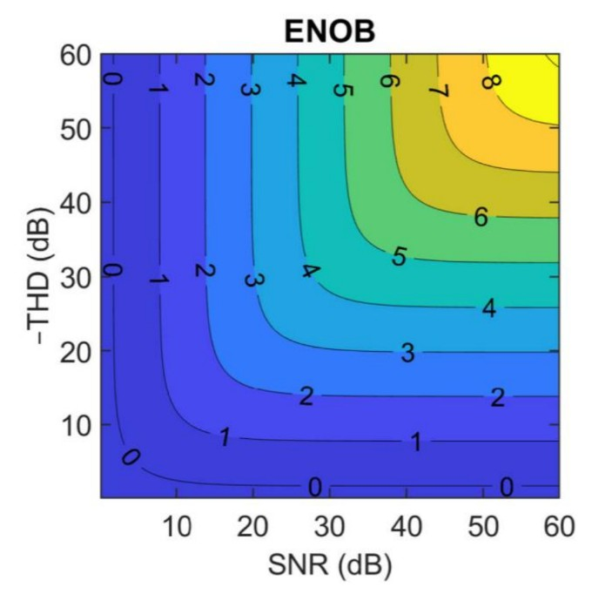

Spectrum analysis
With the spectrum analysis, we apply a pure sine-wave as input and see the spectrum of the mirrored current signal.
With the spectrum analysis, the simulator can calculate these FOMs
$SNR=10∙log⁡(\frac{I_{signal}^{2}}{I_{noise}^{2}})$
$THD=−10∙log⁡(\frac{I_{signal}^{2}}{I_{distorsion}^{2}})$
$SINAD=10∙log⁡(\frac{I_{signal}^{2}}{I_{noise}^{2}+I_{distorsion}^{2}})$
$ENOB=\frac{SINAD−1,76}{6,02}$
Notes:
10

Slide 11
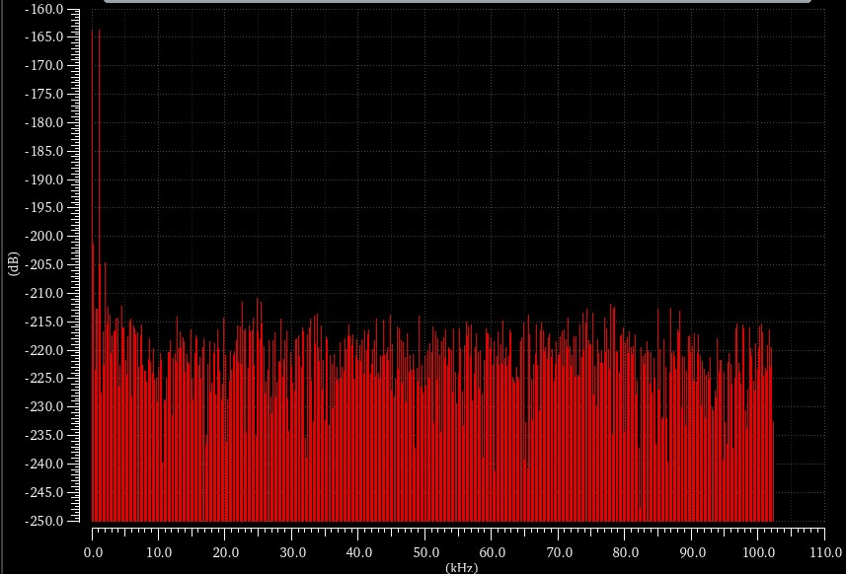

Spectrum analysis
This is the spectrum of the mirrored output wave considering the transient noise of the components.
As we can see, there are two main frequency components that are higher that the others
The component at $f=0Hz$ that is present because the sine-wave is not a zero-mean signal
The component at $f=1kHz$ that is the fundamental harmonic of the output signal
The spectrum analysis has been done with n-mos dimensions of Wn/Ln = 1um/0,8um and p-cap dimension of Wpcap*Lpcap = 5um*5um
In this case the p-cap is charged, so the current mirror have a magnification factor (value of $w$) different from 1. The calculated $ENOB$ refers to a signal that have a magnification factor equal to 1, so the value needs to be corrected by adding the value $−\log_{2}{w}$
Notes:
11

Slide 12

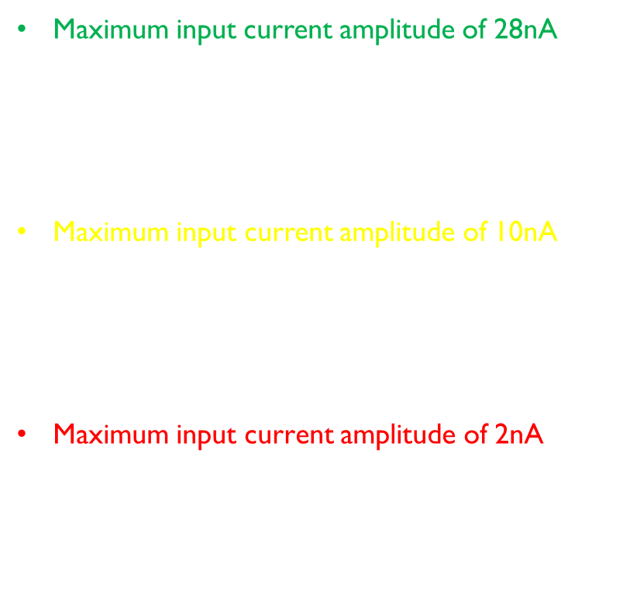
Dependence of ENOB on maximum input current amplitude
Maximum input current amplitude of 28nA
$ENOB≅5,49bits$
$SNR≅34,99dB$; $THD≅−38,74dB$
Maximum input current amplitude of 10nA
$ENOB≅5,06bits$
$SNR≅33,63dB$; $THD≅−39,27dB$
Maximum input current amplitude of 2nA
$ENOB≅4,39bits$
$SNR≅29,64dB$; $THD≅−39,90dB$
The amplitude of the noise frequency components (thermal noise) is independent of the amplitude of the input current waveform.
This means that $I_{signal}^{2}$ decrease. The $I_{distorsion}^{2}$ also decrease, while $I_{noise}^{2}$ remains the same.
As a result, the $SNR$ increase and $THD$ decreases, this means that $SINAD$ ad $ENOB$ increases with the input current amplitude.
We have simulated these values for three different values of input current amplitude to make a comparison. The simulation has been done with Vds = 1V, without charging the p-cap, with n-mos dimensions of Wn/Ln = 1um/0,8um and p-cap dimension of Wpcap*Lpcap = 5um*5um.
Notes:
12

Slide 13
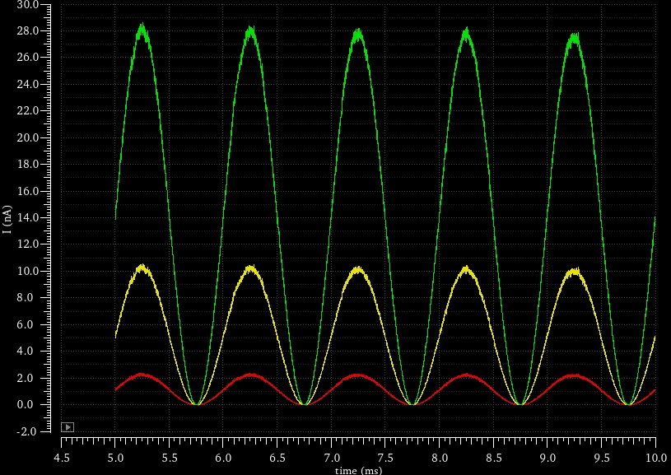
Dependence of ENOB on maximum input current amplitude
Maximum input current amplitude of 28nA
$ENOB≅5,49bits$
$SNR≅34,99dB$; $THD≅−38,74dB$
Maximum input current amplitude of 10nA
$ENOB≅5,06bits$
$SNR≅33,63dB$; $THD≅−39,27dB$
Maximum input current amplitude of 2nA
$ENOB≅4,39bits$
$SNR≅29,64dB$; $THD≅−39,90dB$
Notes:
13

Slide 14
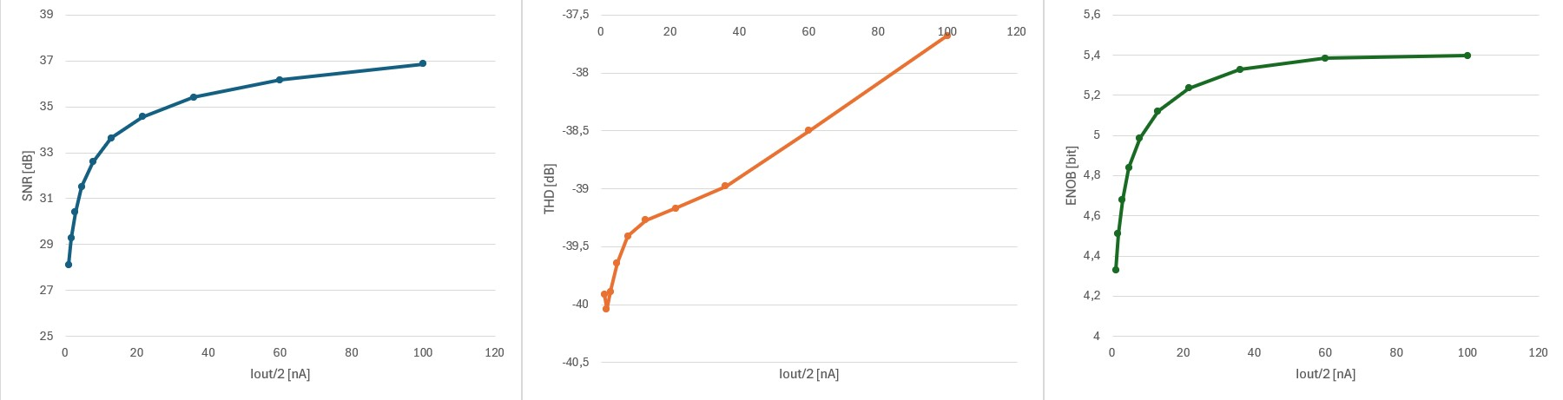

Dependence of ENOB on maximum input current amplitude
As we can see from the graph, the $SNR$ increases with the input current amplitude because the noise spectral component amplitudes are independent of the input current amplitude.
Moreover, the $THD$ decreases because a smaller signal introduces fewer nonlinear effects.
In the graph the current value is Iout/2 because the magnification factor is 1, so Iout = Iin
Notes:
14

Slide 15
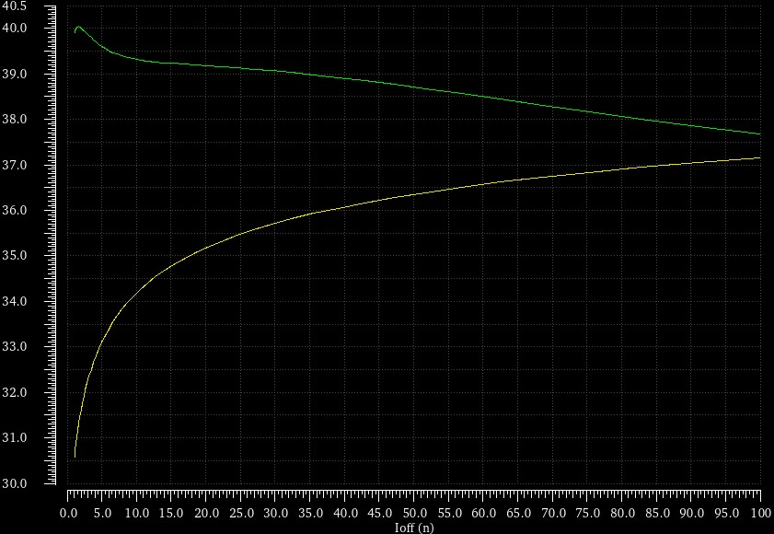
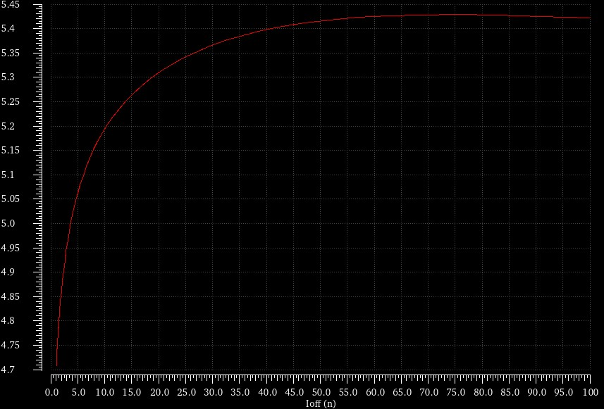
Dependence of ENOB on maximum input current amplitude
To verify that the approximated functions shown in the last slide are correct, we also plotted the same functions in Cadence Virtuoso.
-THD [dB]
SNR [dB]
ENOB
Notes:
15

Slide 16
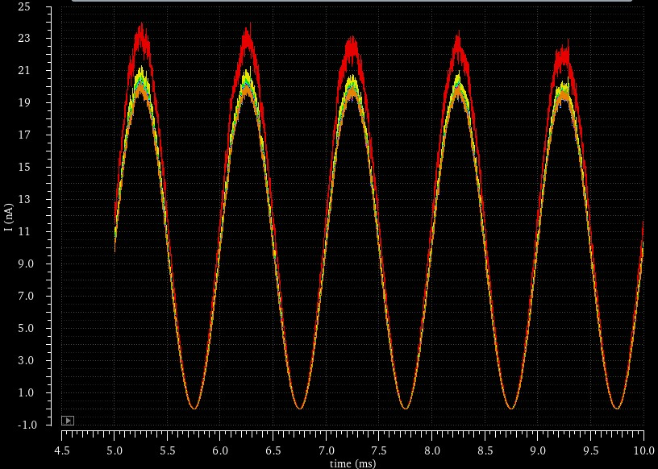
Dependence of ENOB on aspect ratio of the n-mos
The first analysis is performed by keeping the Wn dimension fixed at 1µm and varying the Ln dimension from 1µm to 300nm (corresponding to an aspect ratio ranging from 1 to 3,33).
As we can see, the channel modulation effect becomes more evident as Ln decreases.
This introduce a distortion factor that increase as Ln decrease.
The simulation has been done with Vds=600mV and without charging the p-cap
Notes:
16

Slide 17
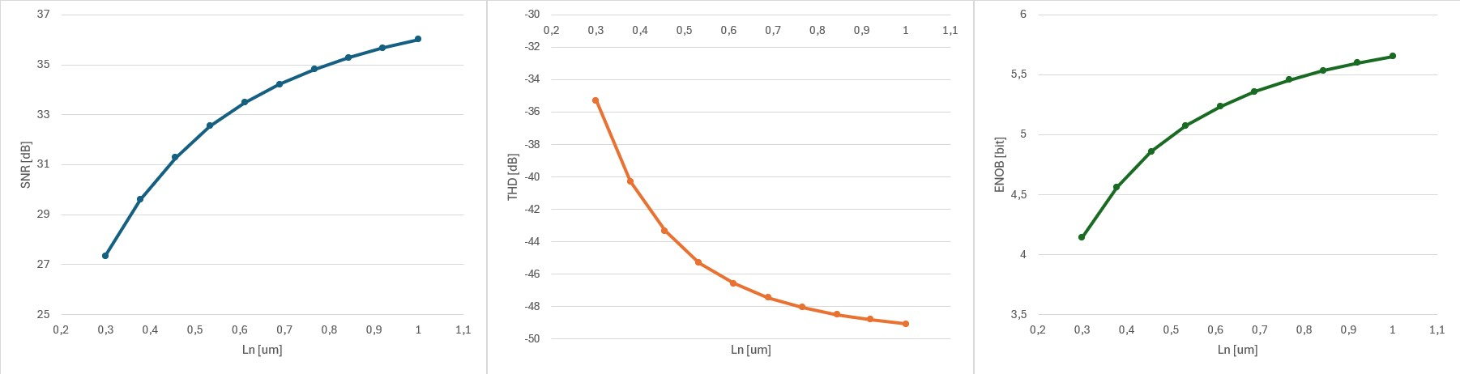

Dependence of ENOB on aspect ratio of the n-mos
As we can see, increasing Ln value increase the $ENOB$ because it introduce less distortions due to channel modulation effect.
Moreover, increasing the n-mos dimensions also improves the $SNR$, because the noise in a mos transistor is inversely proportional to the device dimensions.
Notes:
17

Slide 18
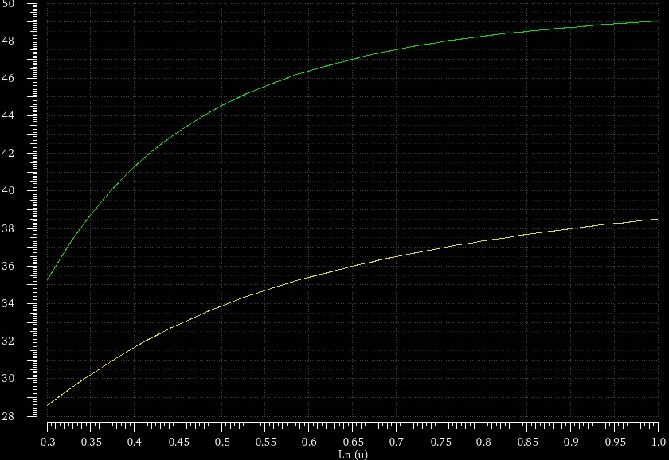
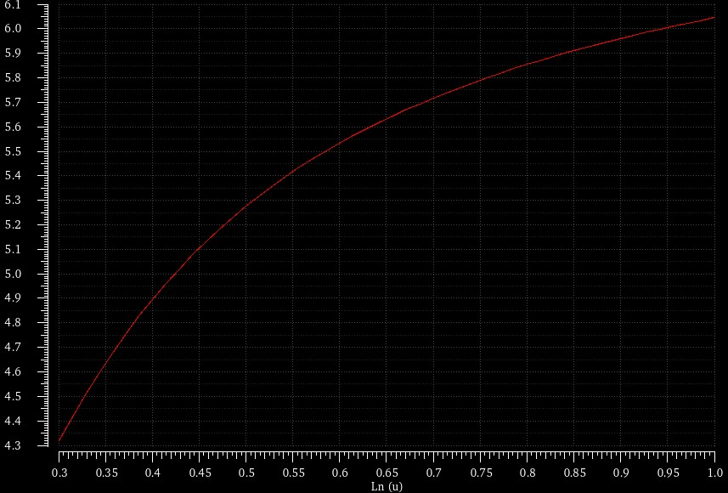
Dependence of ENOB on aspect ratio of the n-mos
To verify that the approximated functions shown in the last slide are correct, we also plotted the same functions in Cadence Virtuoso.
-THD [dB]
SNR [dB]
ENOB
Notes:
18

Slide 19
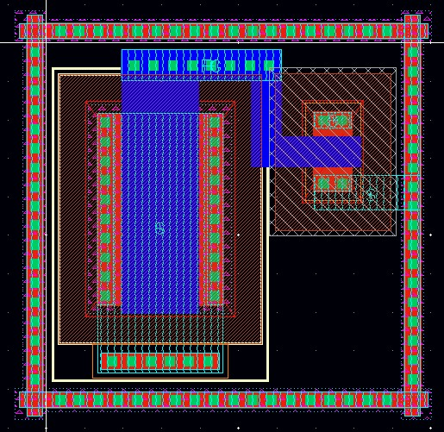

Floating gate cell layout
The floating gate cell designed have the following parameters:
With this dimensions we can calculate the maximum drain current that ensure the mos to work in weak inversion.
$$\frac{I_{ds}}{I_{dspec}}≤\frac{1}{10} →I_{ds}≤\frac{I_{dspec}}{10}=\frac{I_{dspec}^{′}\frac{W}{L}}{10}≅25nA$$
The designed cell can ensure an ENOB value greater than 5 bits with a Vds = 600mV and a maximum input current of 25nA.
Ln = 800nm
Wn = 1um
Lcap = 2um
Wcap = 5um
Notes:
19

Slide 20
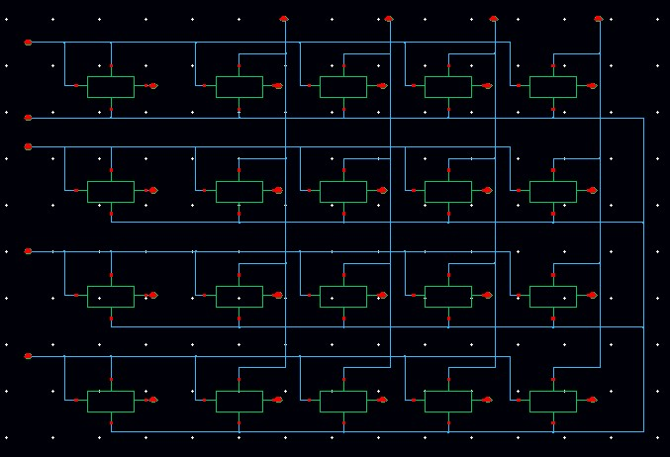
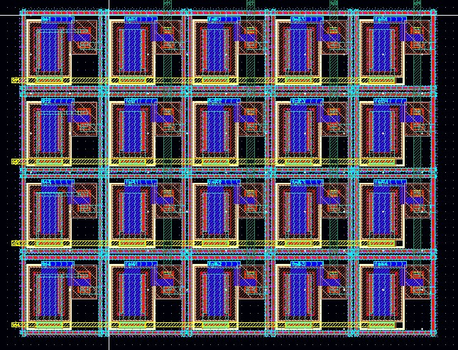
4x4 vmm layout
The floating gate cell designed earlier can be connected to form a matrix of current mirrors.
In this case we designed a 4x4 vmm.
Notes:
20

Slide 21
Thank you for your attention
Notes:
21

